Slide 1
Capstone Project
Credit Card Default Prediction
Team Members
LAKSHMI KEERTHANA
TITO VARGHESE

Slide 2
Points to Discuss
Problem Statement
Data Summary
Data Cleaning
Exploratory Data Analysis
Feature Engineering
Model Training
Evaluation Metrics from model
Conclusion
Challenges

Slide 3
Problem Statement
To extract,observe, analyse and build a classification model based on dataset with the details of credit card holders of a bank in Taiwan for the period April to September, 2005.
The features available include some basic customer demographics (gender, education, marital status and age), available credit line, their history of payment/default for the six months mentioned (Apr--Sep '05), their bill amounts and their payment amounts for that period and a binary target variable indicating default the following month.
We perform some EDA to understand the data and clean the data, engineer relevant features, build predictive models to predict default and perform some statistical analyses to obtain a greater understanding of the features and their interactions. We finish with some case scenarios where the predictive model could be applied.

Slide 4
DATA SUMMARY
The dataset info gives us some crucial insights into our Features data type and Non Null Count:
11 BILL_AMT1 30000 non-null int64
12 BILL_AMT2 30000 non-null int64
13 BILL_AMT3 30000 non-null int64
14 BILL_AMT4 30000 non-null int64
15 BILL_AMT5 30000 non-null int64
16 BILL_AMT6 30000 non-null int64
17 PAY_AMT1 30000 non-null int64
18 PAY_AMT2 30000 non-null int64
19 PAY_AMT3 30000 non-null int64
20 PAY_AMT4 30000 non-null int64
21 PAY_AMT5 30000 non-null int64
22 PAY_AMT6 30000 non-null int64
23 defaulter 30000 non-null int64
# Column Non-Null Count Dtype
--- ------ -------------- -----
0 LIMIT_BAL 30000 non-null int64
1 SEX 30000 non-null int64
2 EDUCATION 30000 non-null int64
3 MARRIAGE 30000 non-null int64
4 AGE 30000 non-null int64
5 PAY_1 30000 non-null int64
6 PAY_2 30000 non-null int64
7 PAY_3 30000 non-null int64
8 PAY_4 30000 non-null int64
9 PAY_5 30000 non-null int64
10 PAY_6 30000 non-null int64
The given dataset consist of 30000 rows and 24 columns
The feature 'defaulter' is our dependent/target feature

Slide 5
DATA CLEANING
Data Cleaning Summary
The given dataset does not contain any missing values
The given dataset had 35 duplicate rows and we have dropped the duplicate records.
The target variable consist of imbalance data with 77.87% Non defaulters(0 value) and 22.12% 1 defaulters (1 value).
Renaming the Column name
Renamed the columns using the first record given in the dataset and dropped the first record.
Renamed our target variable to defaulter and PAY_0 column to PAY_1
Converted the datatypes of all columns from object to int datatype because all columns contains numerical values.
Drop the ID column from the dataset,since its not an influential feature in our modeling.
The Dataset Inspection Summary
The average credit card limit/consumer credit amount is 167484.32(NT Dollars)
The maximum number of credit card holders were females in Taiwan.
The given dataset consist of 30000 rows and 24 columns
The feature 'defaulter' is our dependent/target feature
The most number of credit card holders were having university degree education.
The most of the customers marriage status was Single, who carries a credit card.
The final shape of the dataset after cleaning the records (1373771,27)

Slide 6
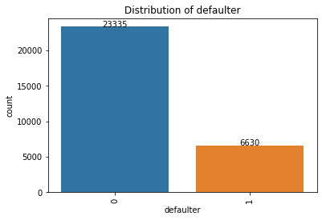
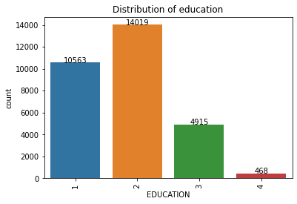
EXPLORATORY DATA ANALYSIS
The target variable consist of imbalance data with 77.87% Non defaulters(0 value) and 22.12% 1 defaulters (1 value).
Most number of customers were holding a university degree as their educational qualification followed by graduates degree holders.

Slide 7
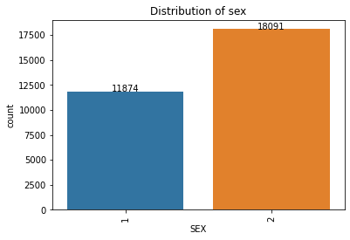
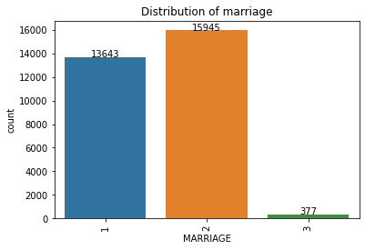
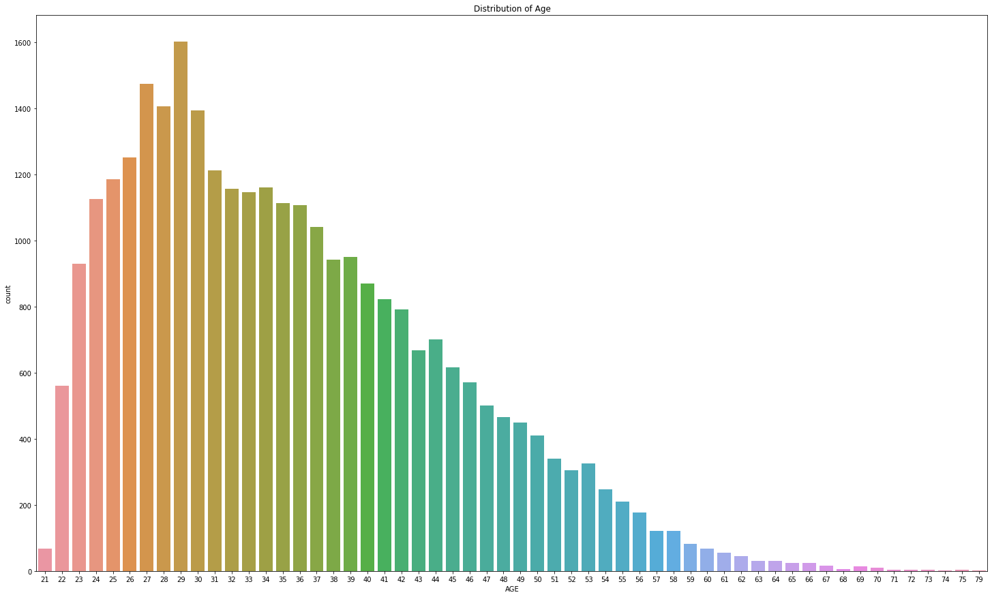
Univariate Analysis
We can conclude that the most number of credit card holders were not married(Single)
The most number of credit card holders in Taiwan were females.
The most frequent age of the credit card holder is between 25-34.

Slide 8
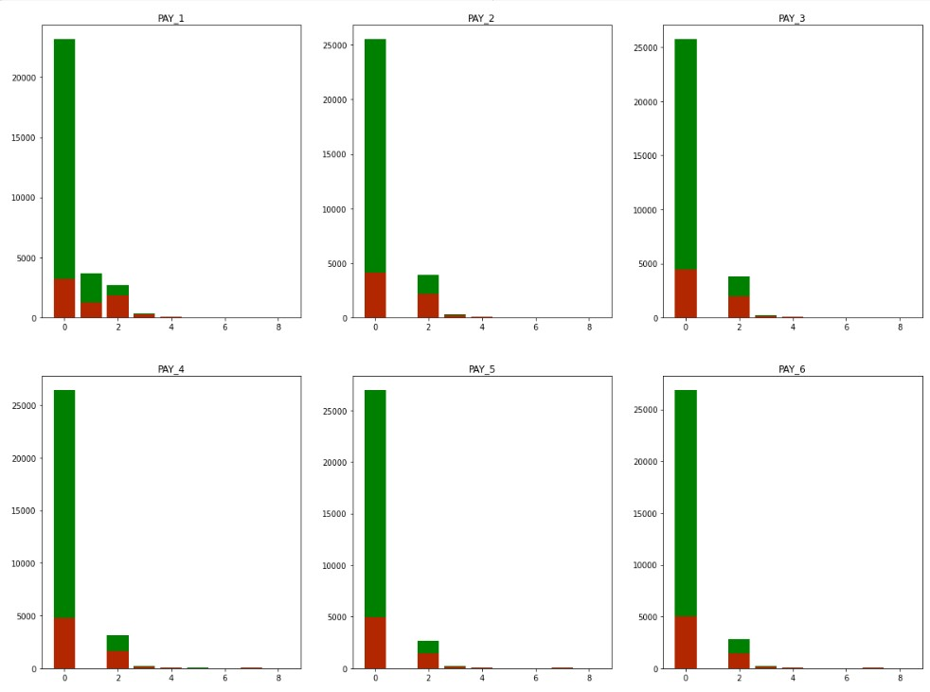
Repayment Status(Payment History)
The above figure shows the bar plot of payment history status for past six months starting from September to April , which show the count of defaulters and non-defaulter
The green bins shows the count of payment status of all the customers (both defaulters and non-defaulters). On the other hand, the red bins shows the count of payment status explicitly for the customers who were defaulters.
From the above graph, we can conclude that if the payment status is greater than 2 months,then there is a 90% chance of the customer to default the payment

Slide 9
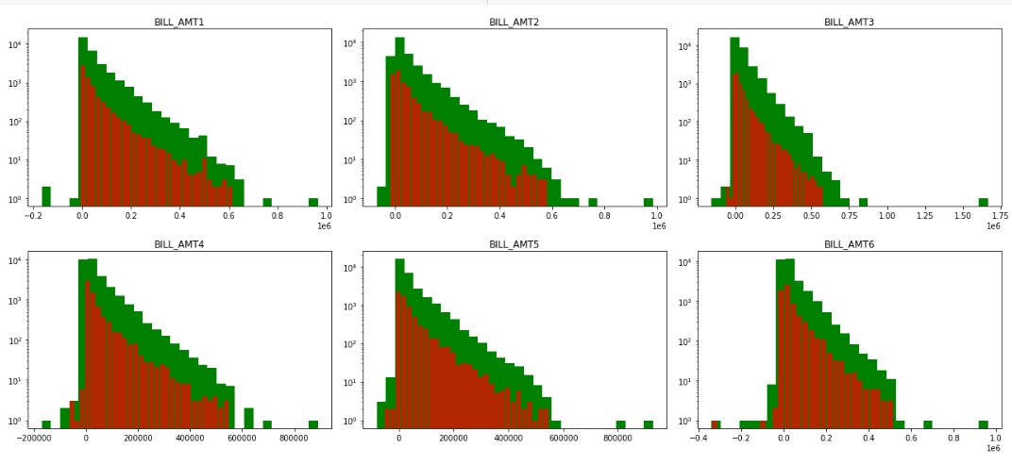
Previous Amount Paid (PAY_AMT)
The above histogram shows the distribution of Bill amount generated for each month explicitly for defaulters
The green bins in the histograms shows the bill_amount for all the customers from September to April Month.
The red bins in the histogram tells the payment amount of customers who were actually a defaulter from September to April Month.
Hence payment amount features are more significant variables compared to the bill amount features.

Slide 10
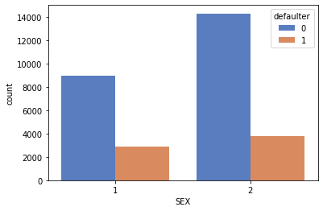
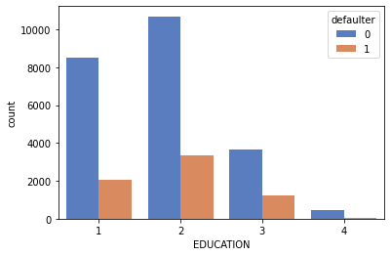
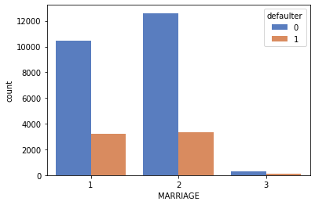
BI-VARIATE ANALYSIS
Defaulter vs Sex
Defaulter vs Education
Defaulter vs Marriage
It is evident from the count plot output that males have overall less default payment rate w.r.t females
The credit card holders with a university degree were the customers with the highest number of default payment rate compared to other degree holders.
It is evident from the plot that both the credit card holders who were singles and married used to do default in payments.

Slide 11
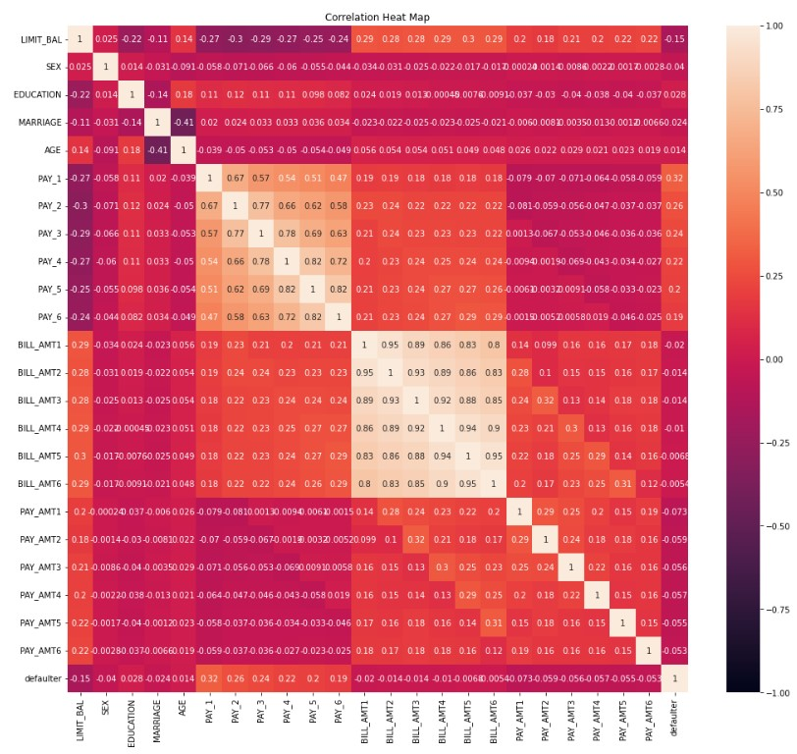
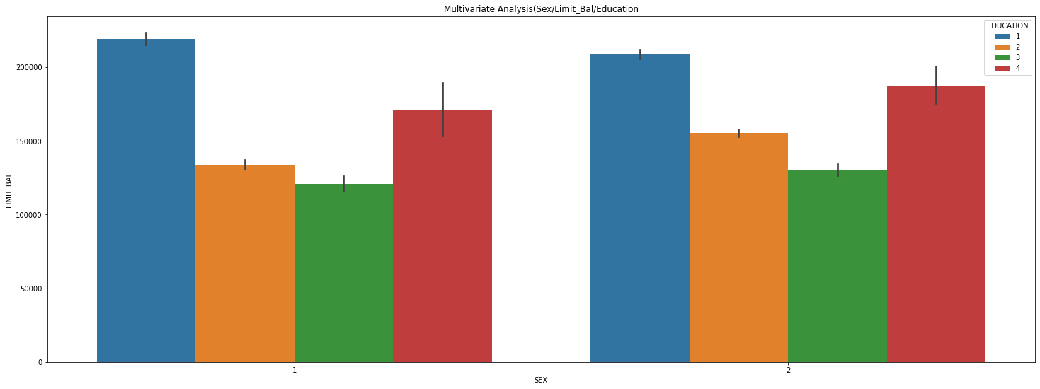
MULTIVARIATE ANALYSIS
Sex vs Credit limit vs Education
HEAT MAP
The above figure tells us that the highest LIMIT_BAL/credit limit amount is given to the graduate education credit card holders in both the sex.
We can see that next month default prediction is dependent on payment repayment status of past six months of all the features given to us. But there is multicollinearity between the Payment Repayment Status features.

Slide 12
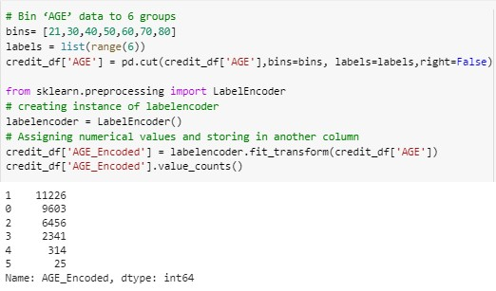
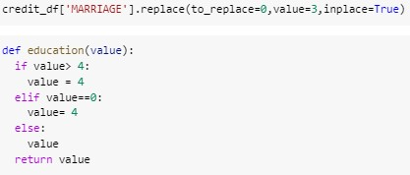
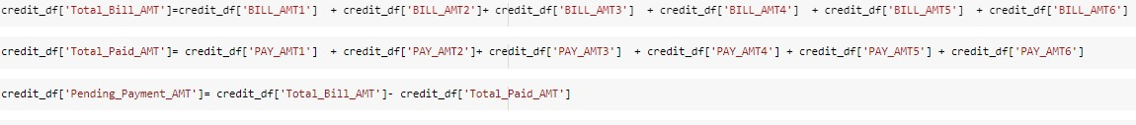

FEATURE ENGINEERING
1.Replaced 0 class/category in marriage column into class/category 3='others' because 0 class is not defined in the marriage variable.
2.Similarly, we replaced few undefined classes like 0, 5 and 6 in education column into class 4='others' using a function name education.
3.Replaced negative values in payment history columns i.e (PAY_1,PAY_2...PAY_6) into class 0 -pay duly on time.
4.Two new Features were derived from the existing independent features,because it will help to train our model more effectively
5.We have also implemented binning on one feature i.e AGE column in order to better train our model efficiently.
6.Lastly performed One-Hot Encoding on few features like AGE,SEX,MARRIAGE and PAY_0-PAY_6 to improve the model evaluation

Slide 13
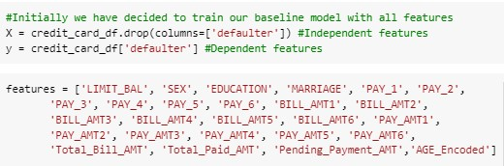
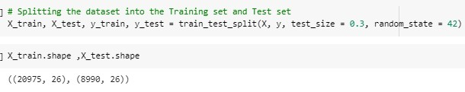

Model Formulation
Initially we handled the imbalance target variable using S.M.O.T.E
The next step for model building is to split the dataset into train and test data
Then, we have performed Standard Scaling technique on the training set using fit.transform and thereafter transformed the test data
After splitting and scaling the dataset, we build a function to train the model using multiple supervised learning algorithms and classify the different models on the basis of their test - train accuracy.

Slide 14
Different Machine Learning Models Used
Logistic Regression
Gaussian Naive Bayes
Support Vector Machines
K-Nearest Neighbour
XGBoost
Random Forest

Slide 15
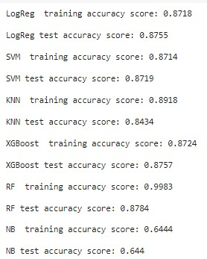
Baseline Model with Default parameters
We can clearly classify our models based on above test accuracy score and the best baseline model is the XGBoost.
Random Forest and KNN models were overfitting using default parameters
Naive Bayes model gave us the least train and test accuracy comparatively.

Slide 16
Logistic Regression
Logistic Regression utilizes the power of regression to do classification One of the main reasons for the model’s success is its power of explainability.
After hyperparameter tuning, from this model we get the results as below:
The accuracy on test data is 0.867
The precision on the test data is 0.902
The recall on the test data is 0.821
The f1 score on the test data is 0.860
The ROC score on the test data is 0.867
Parameters:
{'C': 0.001,
'class_weight': {0: 10, 1: 15},
'penalty': 'l2'}

Slide 17
Gaussian Naive Bayes
Naive Bayes applies what is known as a posterior probability using Bayes Theorem to do the categorization on the unstructured data.
From this model we get the results as below:
The accuracy on test data is 0.641
The precision on the test data is 0.851
The recall on the test data is 0.344
The f1 score on the test data is 0.490
The ROC score on the test data is 0.642

Slide 18
Support Vector Machine
SVM algorithm creates the best line or decision boundary that can segregate n-dimensional space into classes so that we can easily put the new data point in the correct category.
After hyperparameter tuning, from this model we get the results as below:
The accuracy on test data is 0.875
The precision on the test data is 0.937
The recall on the test data is 0.805
The f1 score on the test data is 0.865
The ROC score on the test data is 0.875
Parameters:
{'C': 100,
'gamma': 0.01,
'kernel': 'rbf'}

Slide 19
K Nearest Neighbor
K-Nearest Neighbor (KNN) algorithm predicts based on the specified number (k) of the nearest neighboring data points. Here, the pre-processing of the data is significant as it impacts the distance measurements directly.
After hyperparameter tuning, from this model we get the results as below:
The accuracy on test data is 0.840
The precision on the test data is 0.889
The recall on the test data is 0.778
The f1 score on the test data is 0.830
The ROC score on the test data is 0.840
Parameters:
{'n_neighbors': 15,
'weights': 'uniform'}

Slide 20
Random Forest
A Random Forest is a reliable ensemble of multiple Decision Trees (or CARTs); though more popular for classification, than regression applications
After hyperparameter tuning, from this model we get the results as below:
The accuracy on test data is 0.868
The precision on the test data is 0.9168
The recall on the test data is 0.810
The f1 score on the test data is 0.860
The ROC score on the test data is 0.868
Parameters:
(max_depth=10,
max_features=0.4,
min_samples_leaf=5,
n_estimators=800)

Slide 21
XGBoost
XGBoost is an implementation of gradient boosted decision trees designed for speed and performance.XGBoost works with large, complicated datasets. XGBoost is an ensemble modelling technique.
Parameters:
(gamma=1,
max_depth=10,
max_features='auto',
min_child_weight=20,
n_estimators=23,
reg_alpha=0.1)
After hyperparameter tuning, from this model we get the results as below:
The accuracy on test data is 0.874
The precision on the test data is 0.918
The recall on the test data is 0.822
The f1 score on the test data is 0.867
The ROC score on the test data is 0.874

Slide 22
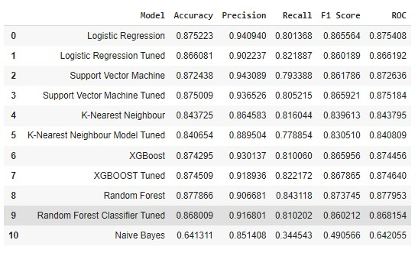
Performance Metrics Summary

Slide 23
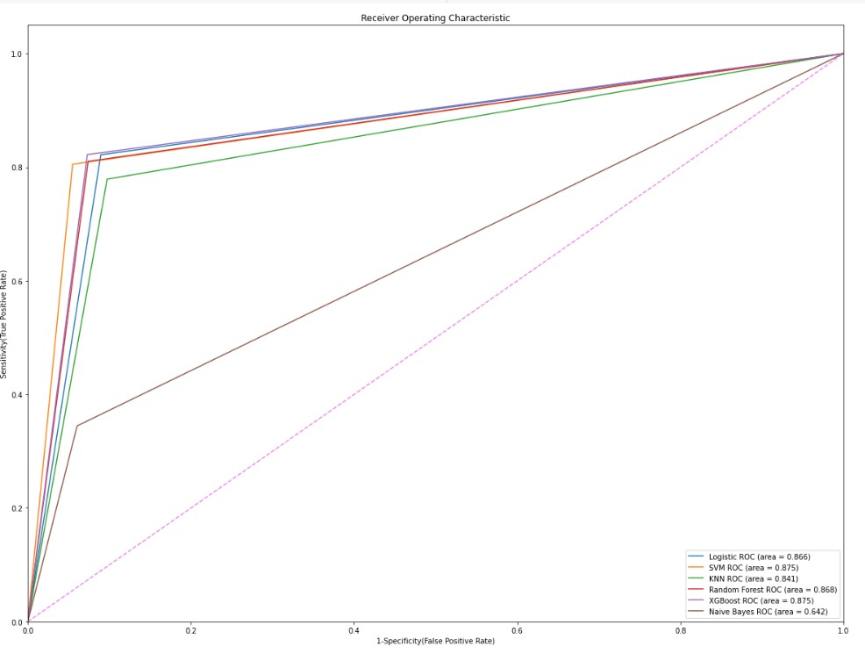
ROC-AUC Curve

Slide 24
Conclusion
1. The maximum number of credit card holders in Taiwan were females and the average credit card limit provided by the credit card company to their respective customers was 167484.32(NT Dollars).
2. The most number of credit card holders were having university degree education and the most of the customers marriage status was Single, who carries a credit card in Taiwan.
3. The highest proportion of credit card holders were youth in the age of 29,thus we can conclude that mostly credit cards were popular among youths of taiwan than the older people.
4. The Correlation between features and target variable tells us the level of education and financial stability of the customers had high impact on the default rate.
5. The data also conveys us that the best indicator of delinquency is the behavior of the customer, which has been predominantly seen in the past couple of months payment repayment status .The heat map shows us the high correlation of payment repayment status with the target variable.

Slide 25
Conclusion
6. Comparatively after hyperparameter tuning the XGBoost Model comes out to be the best model in terms of its AUC_ROC score(0.875) and Recall score(0.82) and we can predict with 87.45% accuracy, whether a customer is likely to default next month.
7. The Second best model was the Support Vector Machine with a AUC_ROC score of 0.875 and a Recall score of 0.805 and we can predict with 87.5% accuracy, whether a customer is likely to default next month.
8. But it would be worth using Logistic Regression model for production since we do not just need a reliable model with good ROC_AUC Score but also a model that is quick and less complex.
9. Except Naive Bayes model,all the models have got really good ROC_AUC scores with a probability of 0.85 on an average.
10.The Random Forest and KNN models were really overfitting with default parameters and we handle the overfit in both these model by fine tuning the model.
11.Demographics: we see that being Female, More educated, Single and between 30-40 years old means a customer is more likely to make payments on time.

Slide 26
Challenges
Extracting new features from existing features were a bit tedious job to do.
Handling Imbalance data in Target features
There were few undefined data records present in the dataset and few duplicate records
The Hyper Parameter tuning using GridSearchCv was really time consuming task and required lots of patience until it get executed
Selecting different parameter for hyperparameter tuning and finding the best parameters has to follow a trial n error technique,which is again a challenging job.

